Slide 1
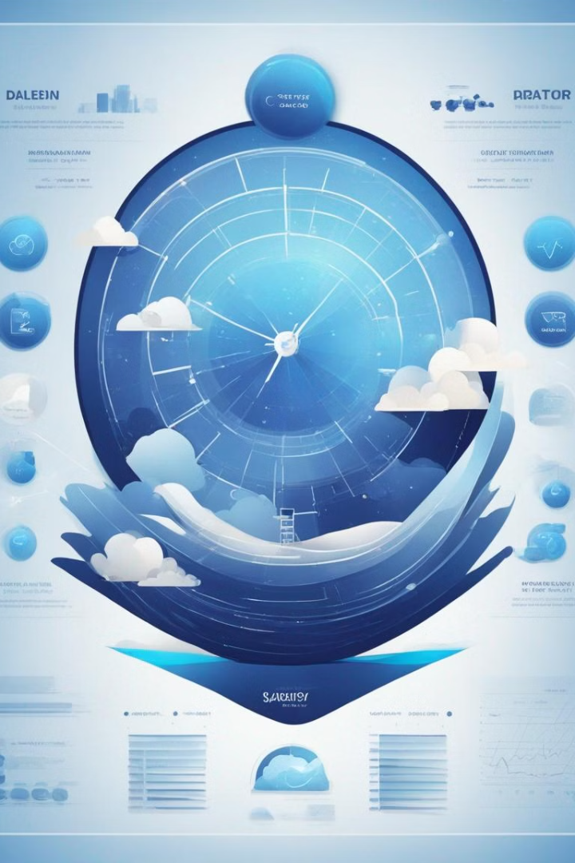
Sleep, Health, and Lifestyle Predictor Website
A sleep, health, and lifestyle predictor website utilizes data analysis, algorithms, and user input to provide personalized insights on health, and lifestyle and predictions related to sleeping disorder.

Slide 2

INTRODUCTION
The website is designed to predict and provide insights into sleep quality, overall health, and lifestyle habits.
The website aims to empower users to make informed decisions about their health and lifestyle habits, leading to improved well-being and quality of life.
Utilizes data analysis, algorithms, and user input to make sleep disorders predictions.

Slide 3
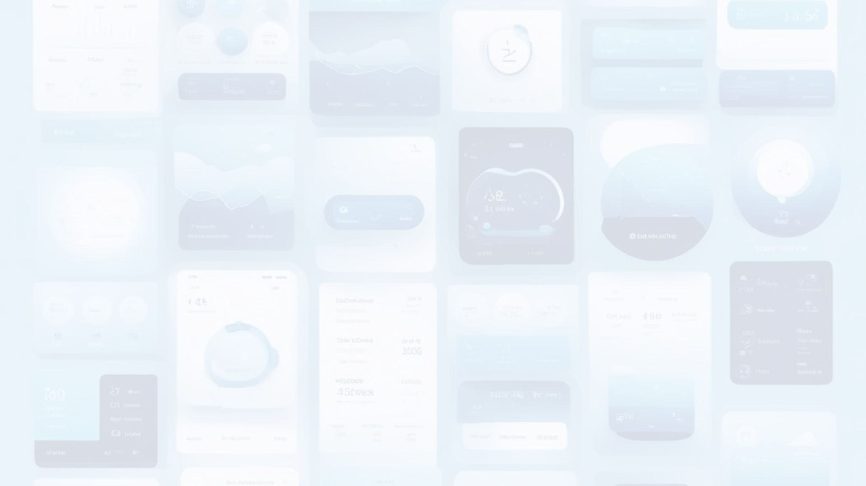
INPUT DATAS
Sleep Patterns and Stress Levels
Users input information about their sleep patterns, including duration and quality and stress levels
Exercise and Other Health Factors
Information such as physical activity, daily steps, BP, Height, Weight etc
Age, Occupation, Gender
Information like Age, Occupation, Gender

Slide 4

PREDICTIONS & ANALYSIS
1
Sleep Disorder Prediction
2
BMI Analysis
The website generates predictions regarding sleep disorders based on the input data.
Calculate BMI and BMI category using height and weight
3
BP Analysis
4
Cardiovascular Analysis
Calculate BP category using Diastolic and systolic Blood pressure
Analysis on Heart Rate

Slide 5

EXISTING SYSTEM
Numerous sleep tracking devices and applications are accessible on the internet. However, most of them focus on monitoring sleep duration and providing an overall assessment of sleep quality. Many sleep trackers primarily focus on total sleep time without delving into the different sleep disorders and sleep quality

Slide 6

PROPOSED SYSTEM
This comprehensive project encompasses the meticulous analysis of a diverse sleep, health and lifestyle dataset. Leveraging machine learning techniques, we have developed an innovative application capable of predicting sleep disorders. Beyond sleep disorders prediction, the application is designed to do analysis on BMI, BP and Cardiovascular health based on user-provided information, thereby promoting overall well-being, and fostering healthier sleep habits.

Slide 7

PROJECT REQUIREMENTS
LANGUAGES
FRONTEND
HTML
CSS
JS
JINJA
BACKEND
PYTHON
FRAMEWORK
DJANGO
Django is a high-level Python web framework that encourages rapid development and clean, pragmatic design. Django follows the Model-View-Controller (MVC) architectural pattern, with models representing the data structure, views handling user interface logic, and templates managing the presentation layer

Slide 8

PROJECT REQUIREMENTS
HARDWARE REQUIREMENTS
PC or Laptop
Processor i5 or more
4GB RAM
SOFTWARE REQUIREMENTS
OS: Windows 10 or 11
IDE: VS code
DATABASE: PostgreSQL

Slide 9
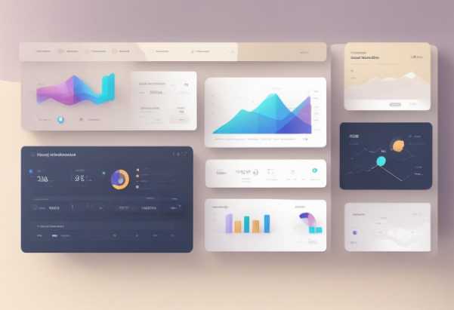

MODULE DESCRIPTION
ADMIN
SLEEPWELL
This module encompasses all administrative functions, superuser activities, and admin sites, along with the associated database tables essential for the seamless operation of a website.
This is the core module which contains basic and overall functions.
Some important files its contains are settings.py - which contains all the settings for the project Urls.py - which contains the main routing urls
Django automatically generates this module during the project creation process.
the module incorporates numerous built-in functions provided by Django to facilitate rapid, straightforward, and efficient development and utilization of the website.

Slide 10


MODULE DESCRIPTION
MAINAPP
HEALTHPROFILEAPP
This module contains mainly 2 pages HomePage About Page views.py and urls.py contain the code responsible for rendering the Homepage (including the index page) and the About page
The module primarily manages user profiles and health records, encompassing functionalities related to sign-in, sign-up, sign-out, and dashboard interactions.urls.py` and views.py files handle routing and processing of requests pertaining to authentication and user interface navigationThis has forms.py file which automatically generate the HTML Forms for us.Models.py file automatically create Database tables and Models

Slide 11
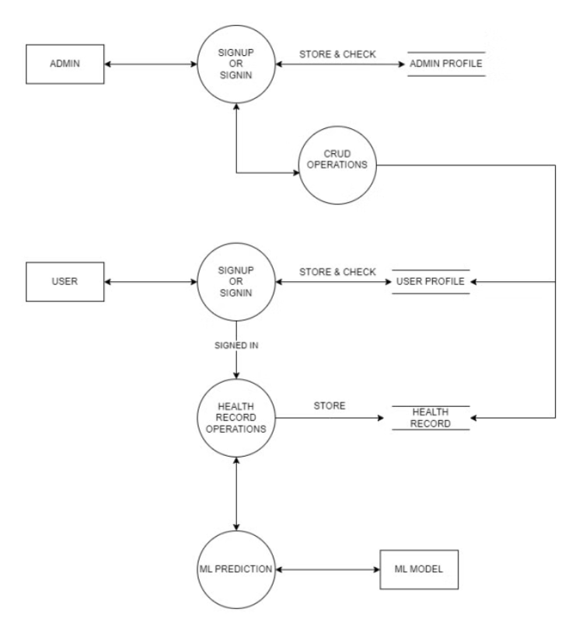
WORKFLOW (DFD)

Slide 12




CONCLUSION
Sleep, health, and lifestyle predictor websites represent a significant advancement in the realm of digital health platforms.
By leveraging technology to analyze user data and provide personalized insights, these platforms offer valuable guidance for individuals striving to enhance their overall well-being.
With their evidence-based predictions and analysis, these websites empower users to take proactive steps towards improving their health and lifestyle habits.

Slide 13

FUTURE SCOPE
The future holds immense potential for the development and expansion of sleep, health, and lifestyle predictor websites.
Integration of Wearable Technology
Collaboration with Healthcare Providers
Enhanced User Experience
Expansion of Predictive Capabilities

Slide 14

REFERENCES
Understanding Blood Pressure Readings | American Heart Association
BMI Calculator
Sleep Foundation | Better Sleep for a Better You
Machine Learning in Healthcare - PMC (nih.gov)
Digital health data-driven approaches to understand human behavior | Neuropsychopharmacology (nature.com)

Slide 15

THANKYOU…

